Slide 1

GBH: Boston Bus Equity
Fall 2024

Slide 2






Team Breakdown
Mi-Ru Youn
Data Science
1st Year Master
Huihao Xing
Data Science
1st Year Master
Chen–Yu Liu
Data Science
1st Year Master
Namika Takada
Data Science
1st Year Masters
Youran Geng
Data Science
1st Year Master

Slide 3
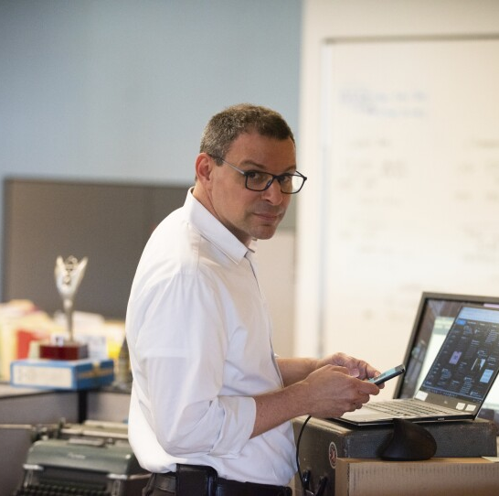
GBH Impact and Equity: Boston Bus Equity
GBH/Paul Singer: Singer is a Senior Editor, Equity & Justice, at GBH News, the local NPR affiliate. This project is intended to support the production of news stories.
CLIENT
project Description & context
Public transport in Boston has a nearly 400-year history, with the first ferry services starting in the 1600’s. Today, the MBTA is a staple of the Massachusetts bay area, serving more than 1 million people a day. The added economic value of the MBTA for the greater Boston area is estimated to be around 11.5 billion per year. Public transport plays an important role in the quality of life for residents in Massachusetts and Boston in terms of economic development, the environment, and equity. It is important to note that public transit is managed by the MBTA, a state agency, and not the City of Boston but they can provide input into decisions such as bus routes, on behalf of the community. The goal of this project is to better understand the impact of bus performance on Boston residents by using MBTA bus data to examine service performance trends by geography.
Paul Singer
Senior Editor, Equity & Justice, GBH News
expected final deliverables
Deliver a detailed analysis of MBTA bus performance (2019–2022).
Compare ridership and reliability data for each bus route across the years.
Identify areas where bus service can improve to meet community needs.
Inform data-driven decision-making for policymakers and the MBTA.
Enhance overall transit system performance to better serve Boston residents and communities.
Notes:
This project aims to deliver a detailed analysis of the Massachusetts Bay Transportation Authority (MBTA) bus performance between 2019 and 2022. The main focus is to compare the ridership and reliability data for each bus route between the years. This study will identify any areas where bus service could be improved to better meet community needs. By analyzing the performance for each route, this project can inform data-driven decision-making for policymakers and MBTA to enhance overall transit system performance to better serve Boston residents and communities.

Slide 4
Process
Stage 1
Stage 1
Gather Required Datasets
Gather Required Datasets
Stage 4
Stage 4
Stage 2
Stage 2
Received Feedback
Received Feedback
Conduct Preliminary Analysis
Conduct Preliminary Analysis
Stage 3
Report Findings with Paul Singer

Slide 5
Process
Arrival & Departure Data (2019 & 2022)
Remove missing value (missing value percentage < 1%)
(2019 01-03, half_trip_id: 0.002%, time_point: 0.025%, actual: 6%)
Wrong “Scheduled”, “Actual” time format (1900-01-01 H:M:S) >> (2019-M-D H:M:S)
The scheduled departure order of buses does not always match the actual departure order.
Trip id Time point id Time point order Scheduled Depart Actual Depart

Slide 6
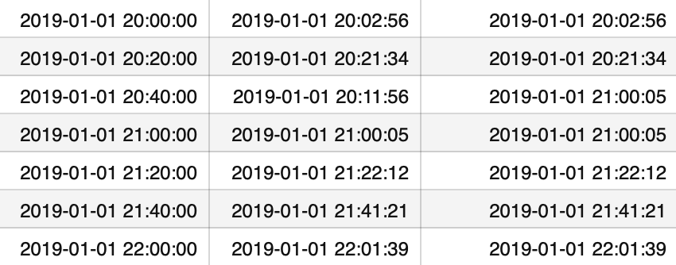
Process
Add a new variable "the next earliest departing bus at this time.":
for each ‘route’, ‘direction’, ‘stop_id’, search the next earliest actual departure bus
Scheduled Depart Actual Depart Next Earliest Bus
Notes:
Client Notes: Why would a bus depart 30min early like in row 3?

Slide 7
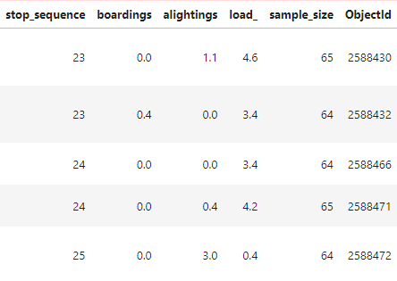
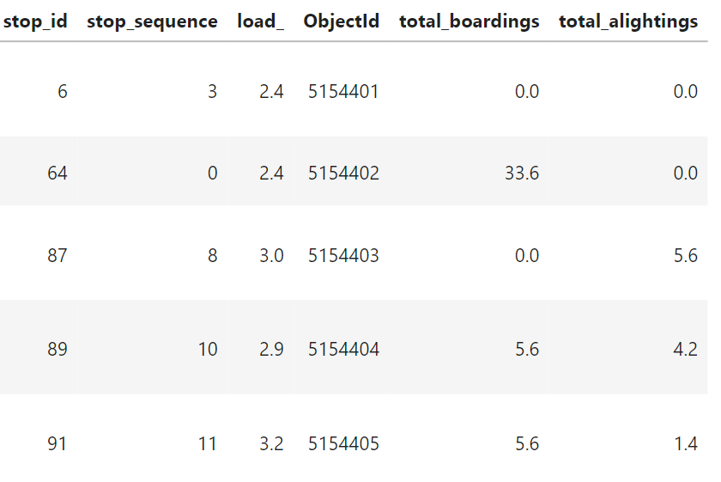
Process
Bus Ridership Data (2019 & 2022)
Changed from average boarding and alighting to total boarding and alighting
Dropped old columns and added new boarding and alightings
Notes:
Client Notes: Find out a better explanation of the boardings and alightings. Perhaps it’s a flaw in the data. Even if it had no missing values, the could be represented differently, like labeled at 0.0.

Slide 8
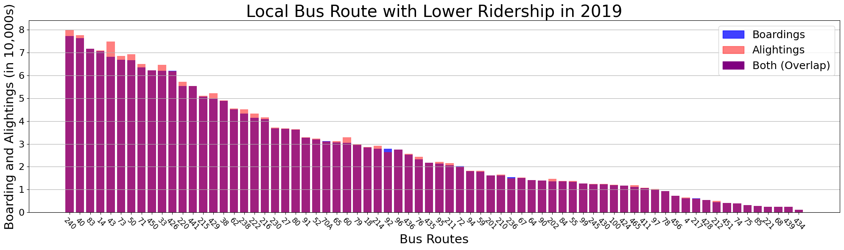
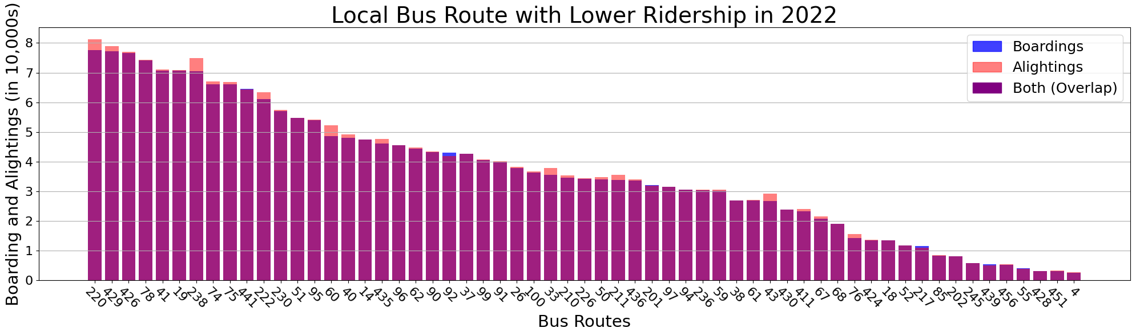
Question 1:
What is the ridership per bus route?
Ridership is sorted by descending boarding numbers

Slide 9
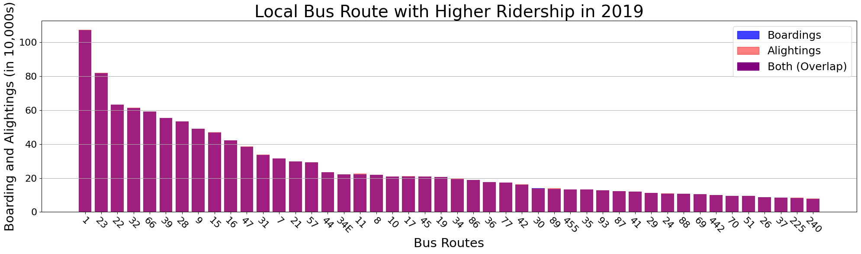
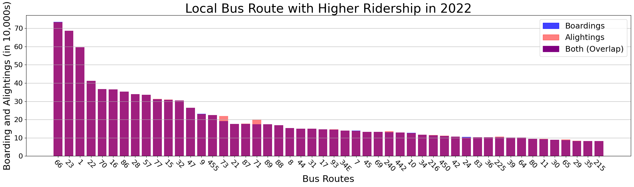
Question 1:
What is the ridership per bus route?

Slide 10
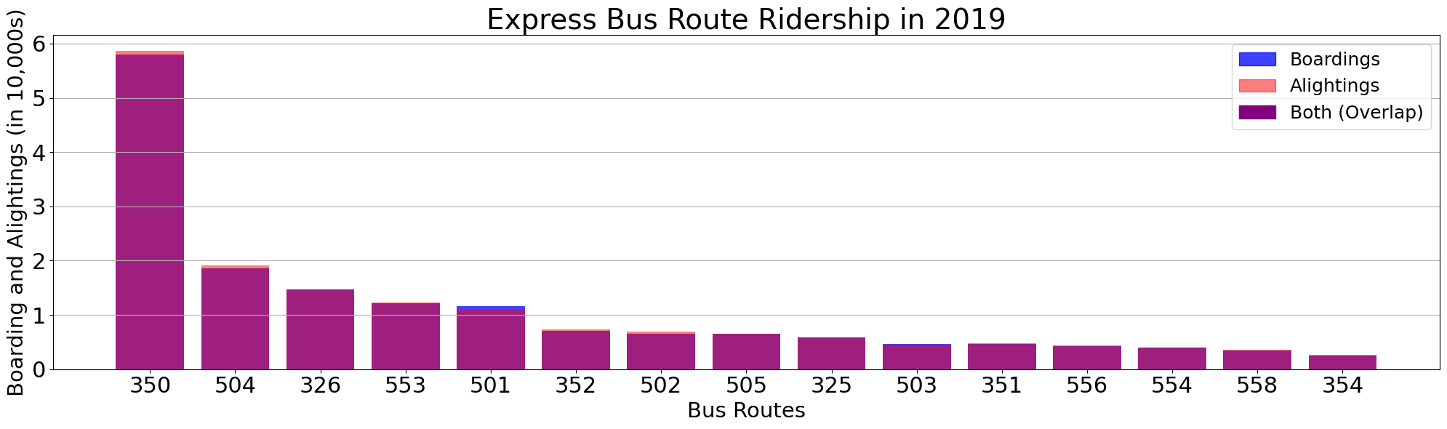
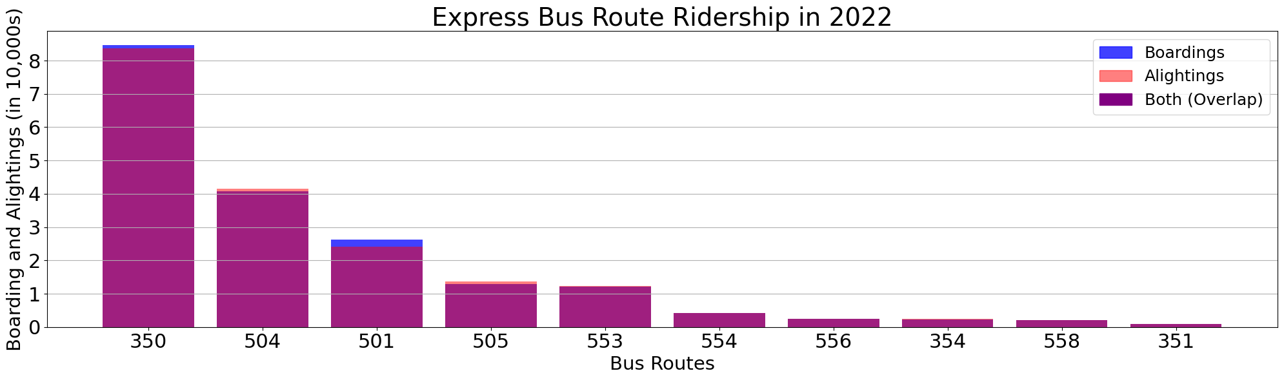
Question 1:
What is the ridership per bus route?

Slide 11
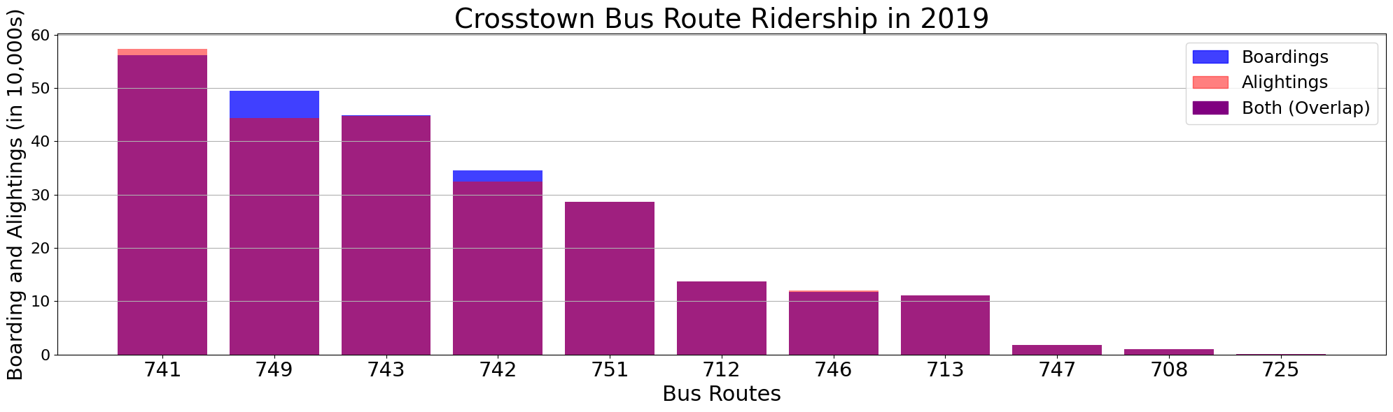
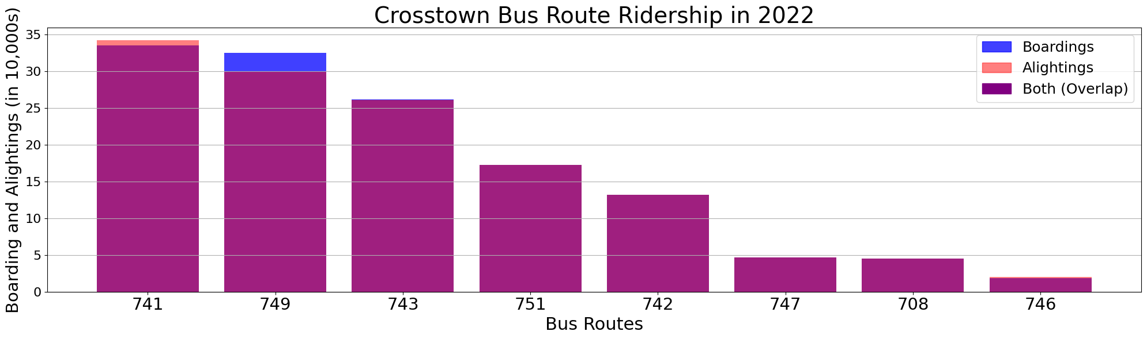
Question 1:
What is the ridership per bus route?

Slide 12
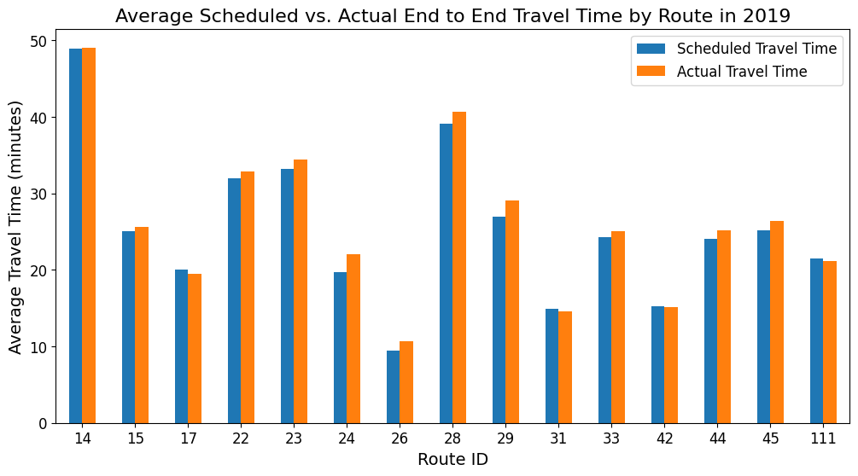
Question 2:
What are the end-to-end travel times for each bus route in the city?
End-to-end travel time represents from starting point to finish point in one direction.
Average year-round scheduled and actual travel times

Slide 13
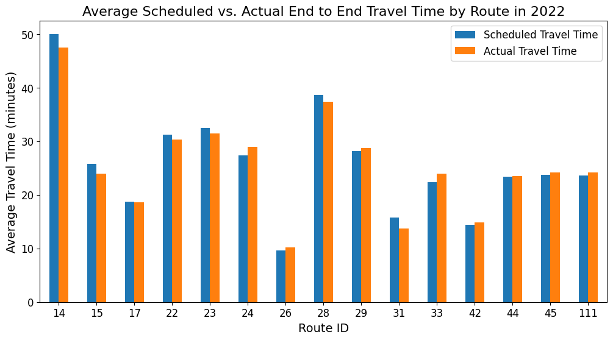
Question 2:
What are the end-to-end travel times for each bus route in the city?
Overall, bus travel time has decreased compared to 2019
Bus Route 23 and 28
~ 3 minute decrease
Only two buses has seen an increase in average travel time
Bus Route 111
~ 3 minute increase
Bus Route 24
~ 7 minute increase

Slide 14
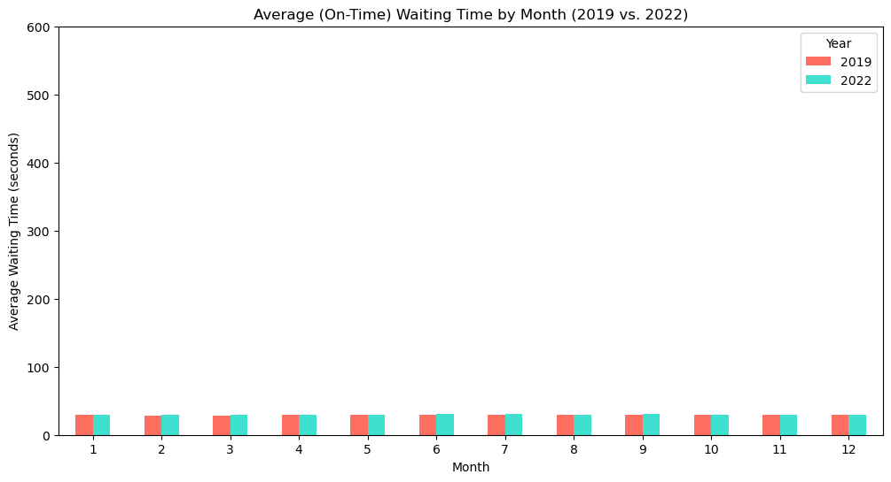
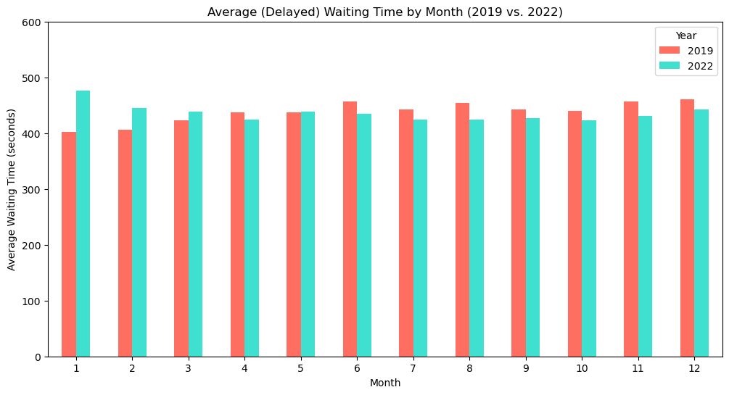
Question 2.1:
On average, how long does an individual have to wait for a bus (on time vs. delayed)?
Buses arrived within 1 minutes are considered “on time”
Rest buses are categorized as delayed
Waiting time is 29 seconds on average for “on time” buses
Waiting time is 437 seconds on average for delayed buses

Slide 15
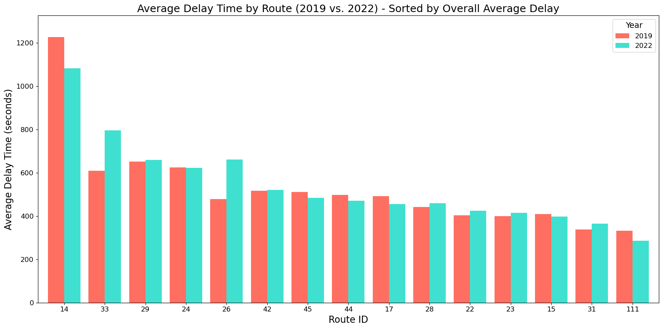
Question 2.2:
What is the average delay time of the target bus routes?
Something is special with Route 14…

Slide 16
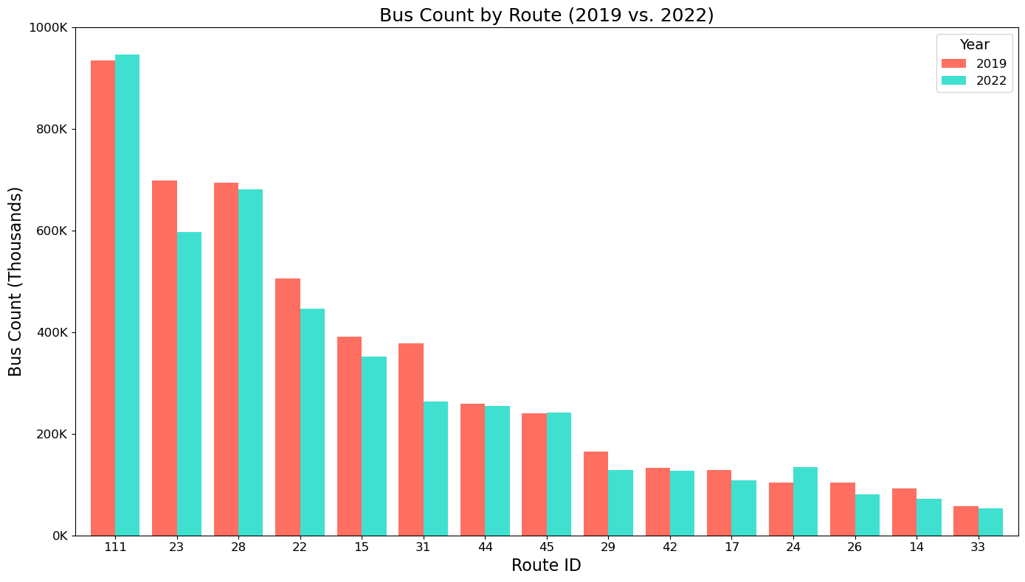
Question 2.2 extended:
What is the average delay time of the target bus routes?
Sort in descending order by 2019 bus count for each route
The Route 14 has only few counts compared to other
This is a signal suggesting that the wait time can be affected by outliers

Slide 17
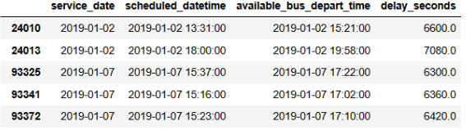
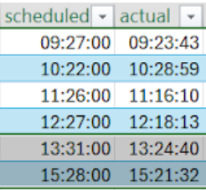
Question 2.2 extended:
What is the average delay time of the target bus routes?
If a rider miss the bus at 1:31 PM because the bus leave earlier, the rider will have to take the bus depart at 3:21 PM
We list some outliers

Slide 18


New Waiting Time
Actual Depart Time
Actual Depart Time
13:31
15:28
15:21
13:24
Schedule Depart Time
Schedule Depart Time

Slide 19
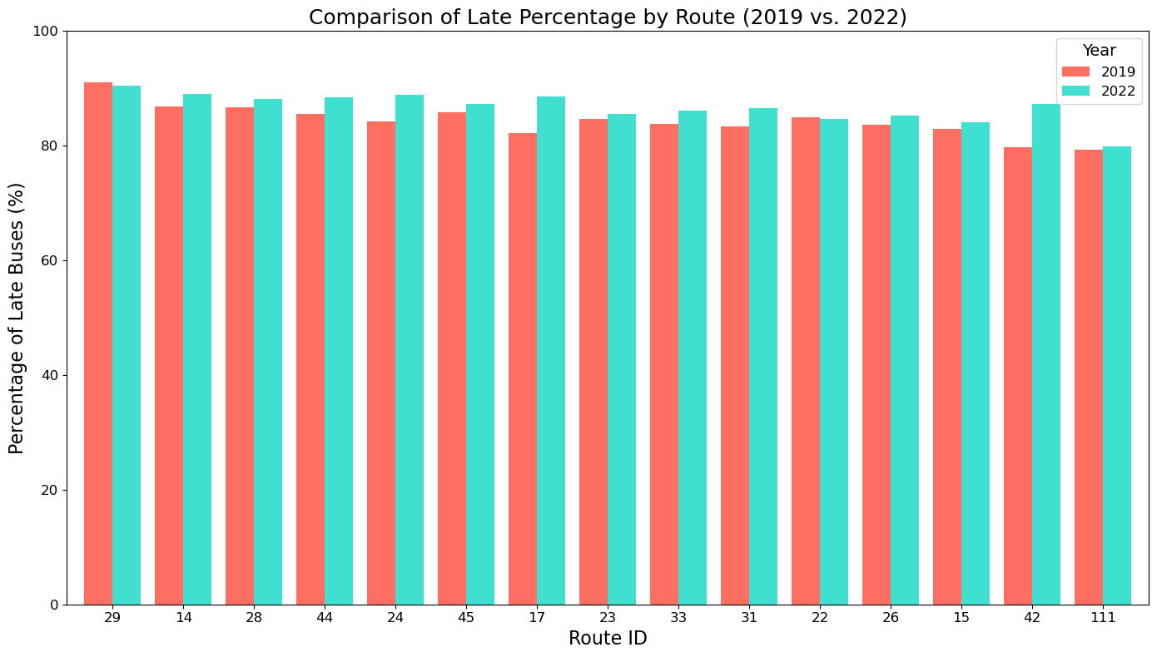
Question 3:
Are there disparities in the service levels of different routes (which lines are late more often than others)?
Sort in descending order by overall percentage (2019 +2022)
Percentage of buses arriving at least 60 second later than scheduled time
No significant disparity in the service level

Slide 20
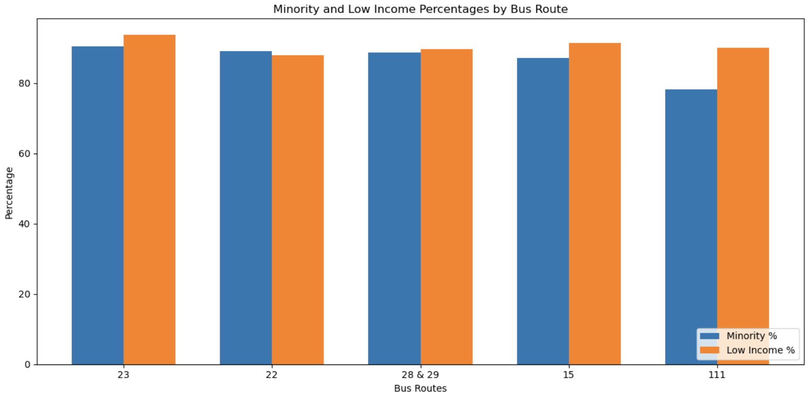
Question 3.1:
If there are service level disparities, are there differences in the characteristics of the people most impacted? (Map over census tract)
Bus routes facing the most significant delays serve areas with highest percentages of minority and low income populations.

Slide 21
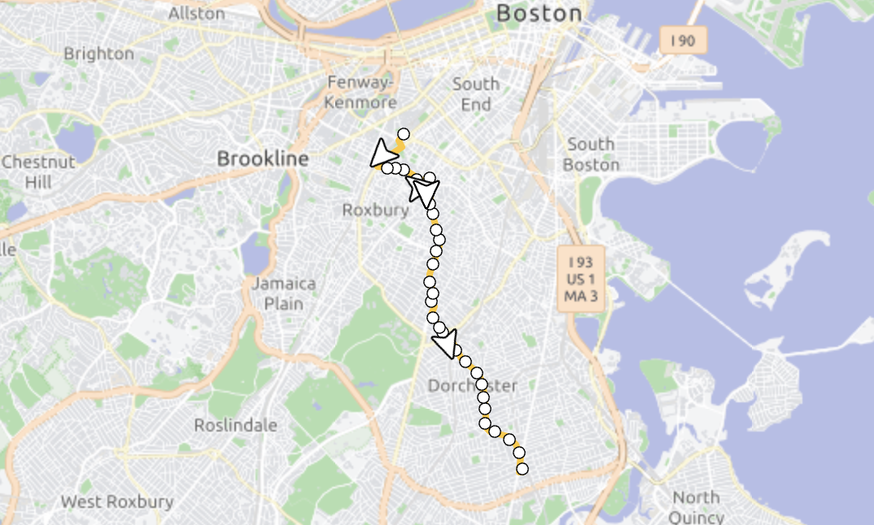
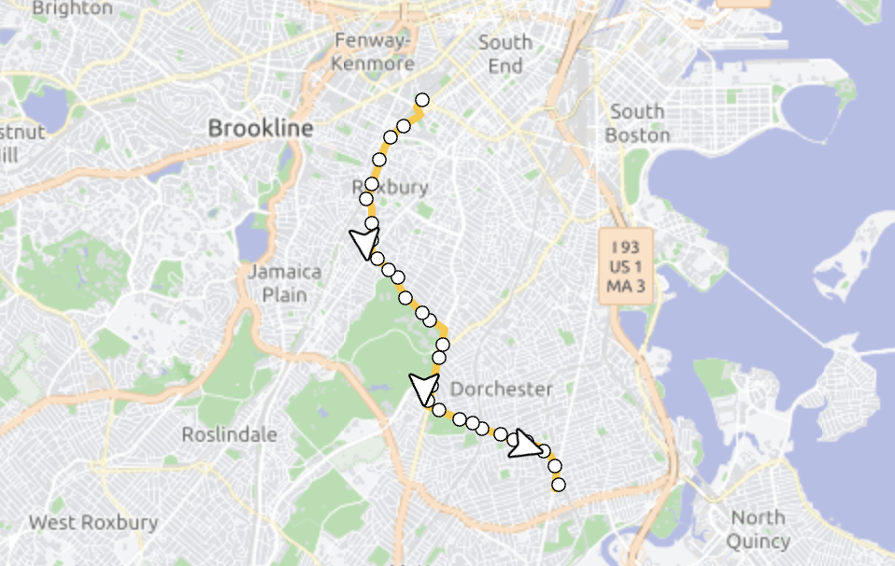
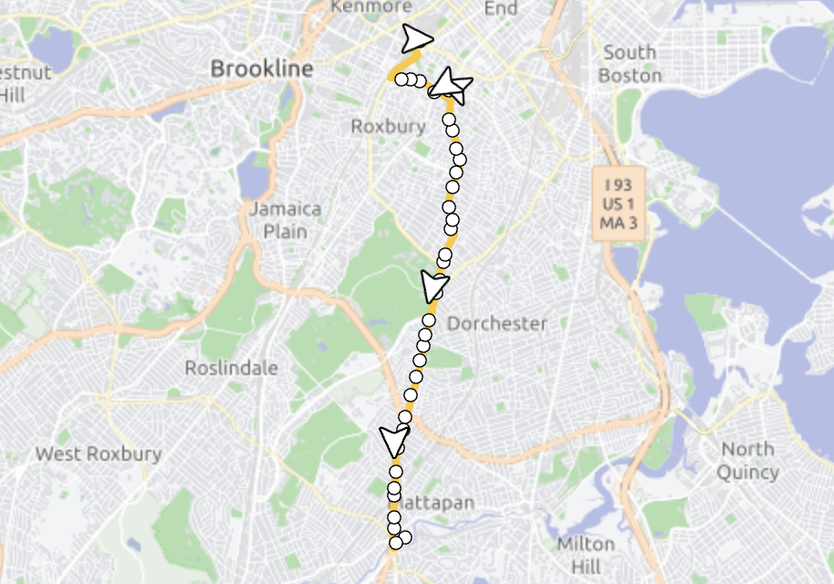
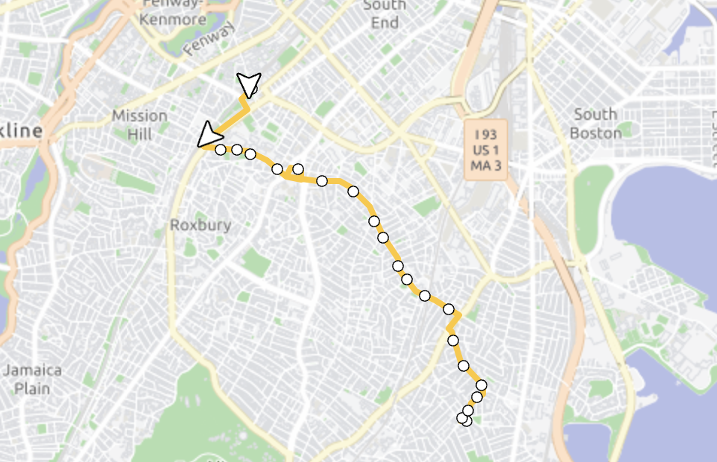
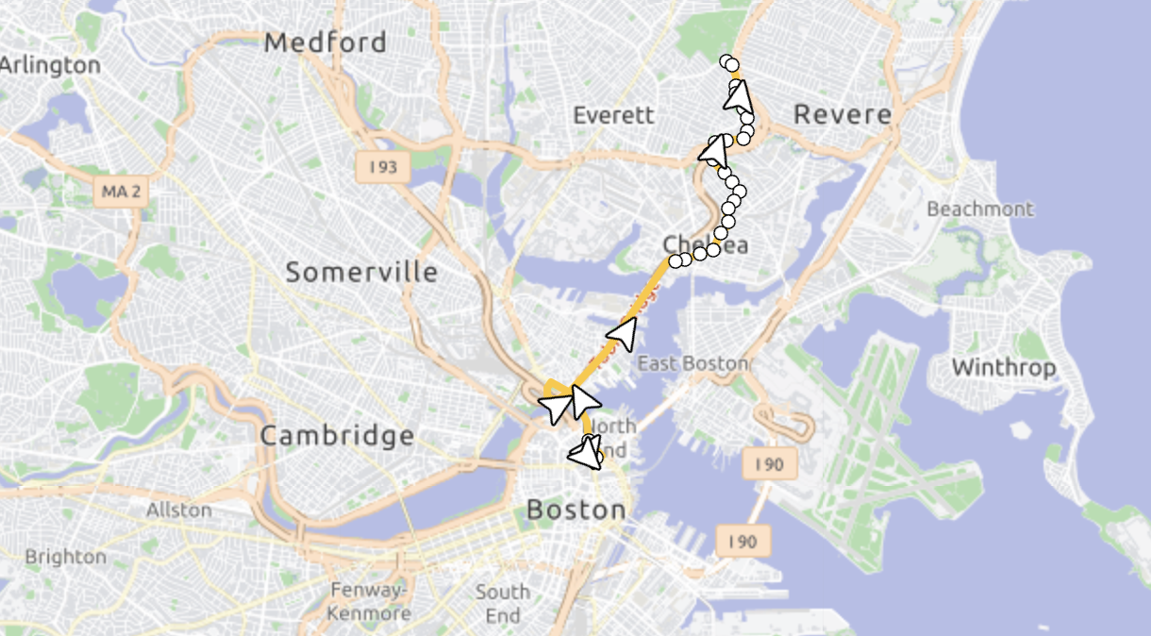
Question 3.1:
23, 22, 28 & 29, 15 are services that connect Environmental Justice Communities

Slide 22
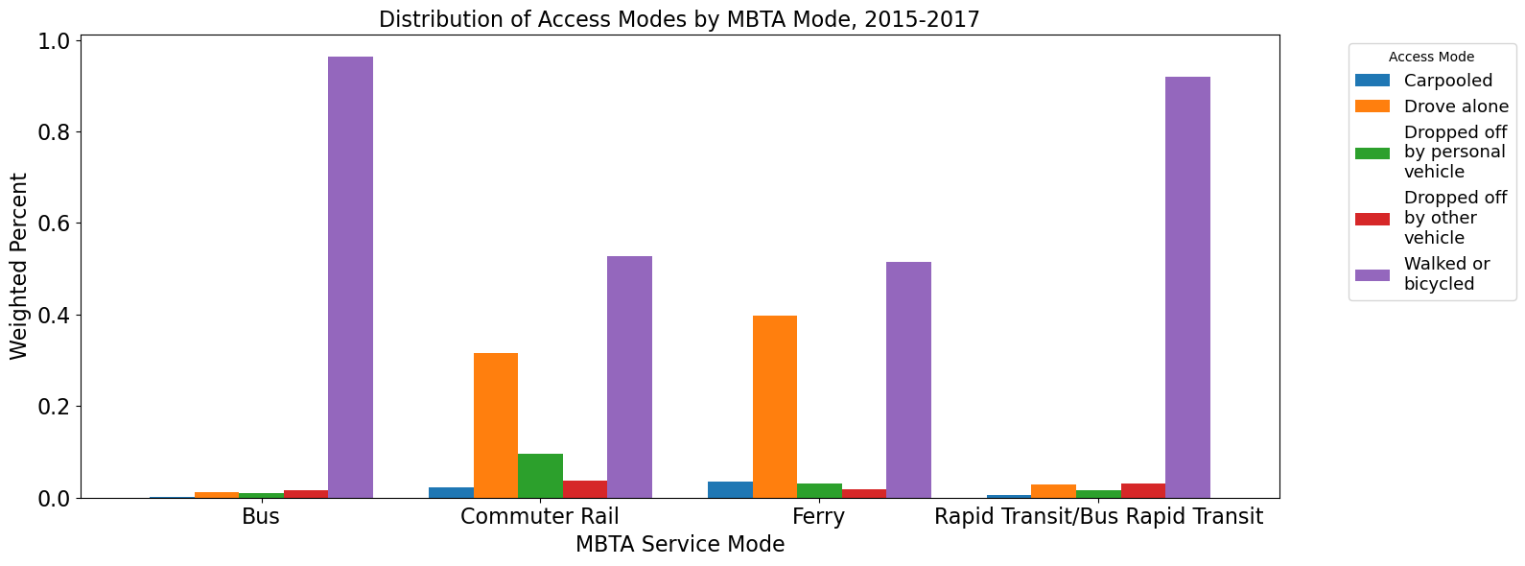
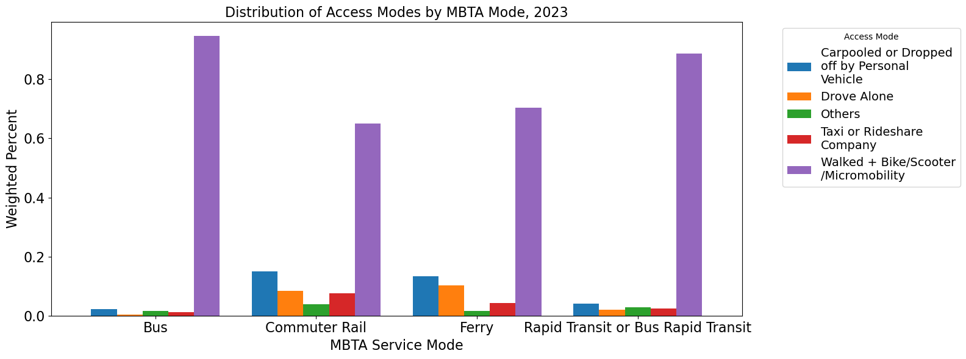
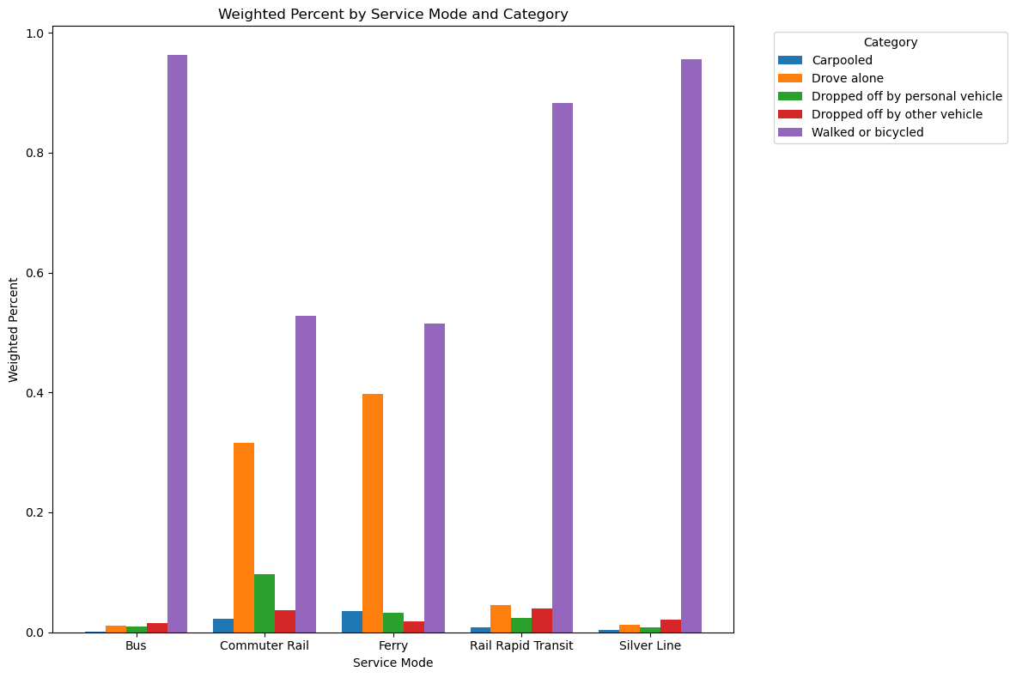
Question 3.2:
Can we chart changes over time?
People are “driving alone” to commuter rail and ferry stations
Significant drop in percentage in post-pandemic era
Most people travel for work (over 60% post-pandemic and over 70% pre-pandemic)
This implies that those people are either leaving the job or switching to remote work
Conclusion: Need to improve the MBTA network (especially for commuter rails and ferries) to adapt shift of work patterns and the commute needs

Slide 23
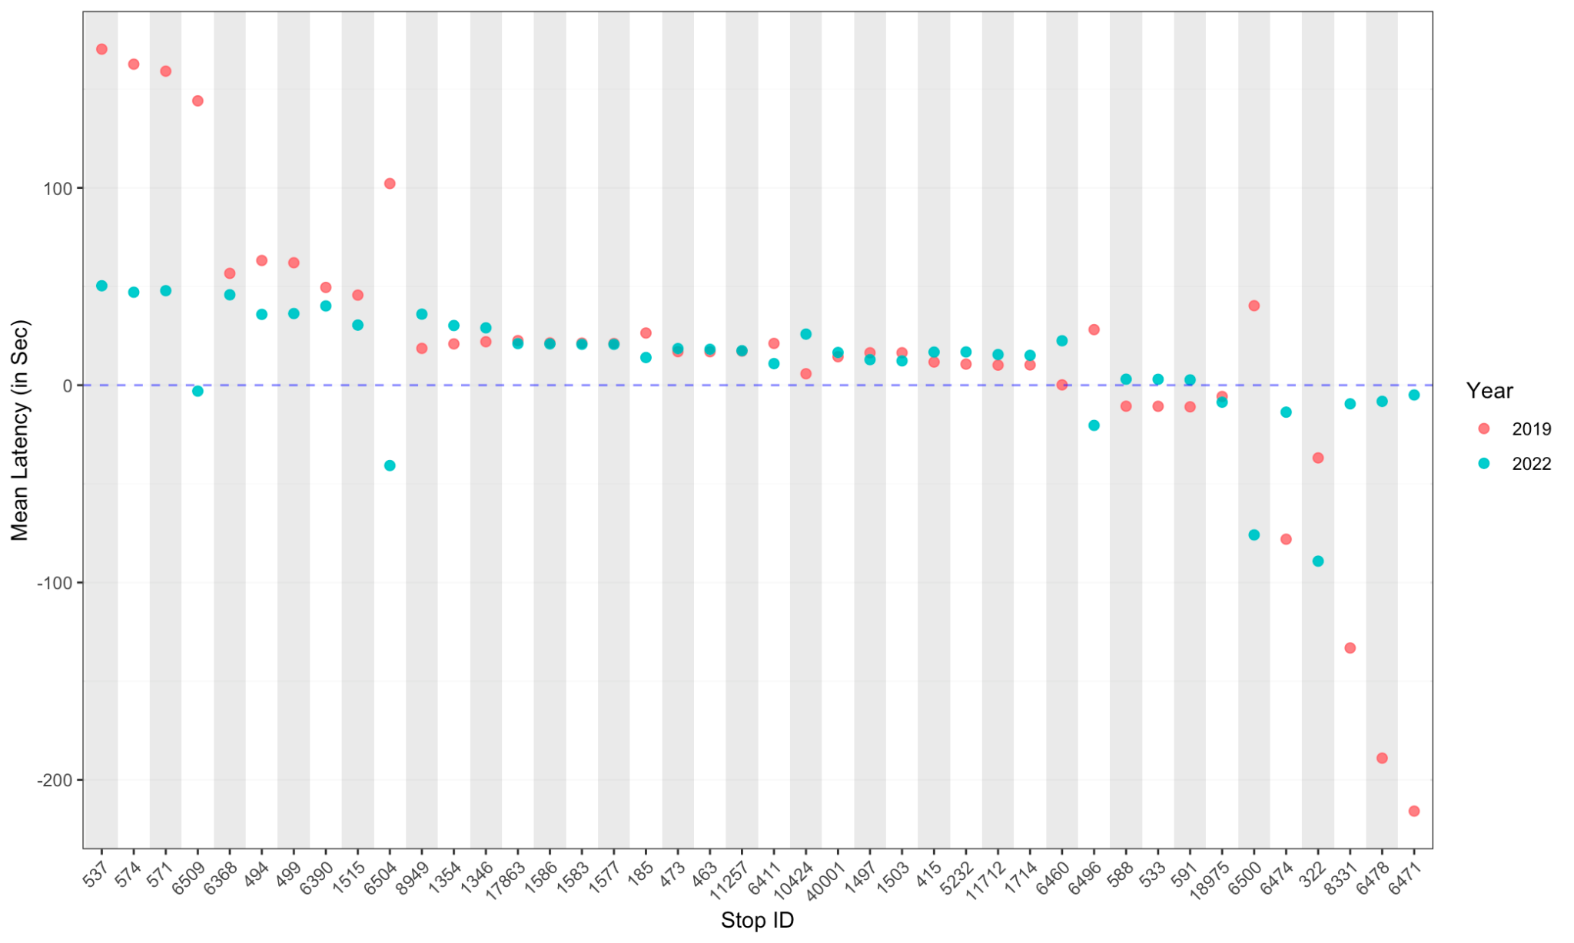
Additional Question :
Departure latency for each bus stop
For each stop:
latency = (actual - scheduled) headway

Slide 24
Conclusion
Prioritizing EJ Routes: Enhancing service frequency and reliability for routes serving EJ communities.
Data-Driven Adjustments: Continuously monitoring performance metrics to adapt operations effectively.
Investing in Infrastructure: Allocating resources for better scheduling, operational enhancements, and additional buses for high-demand routes.
Ensuring Timely Departures for Low-Frequency Routes: Preventing early departures on buses with fewer trips to avoid long wait times for passengers. Ex: Route 14

Slide 25
Questions
Notes:
In the report – map out the routes

Slide 26

Thank you!

